Slide 1
Low power approximate multiplexer using compressor
Guided by:
k.sivanandam , ap/ece

Slide 2
Content:
Introduction
Problem identification
Architecture design for multiplier

Slide 3
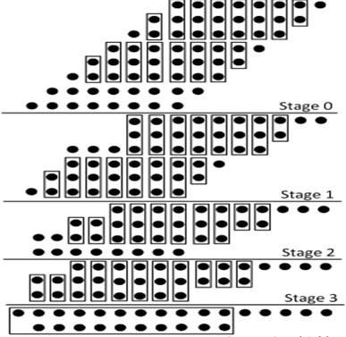
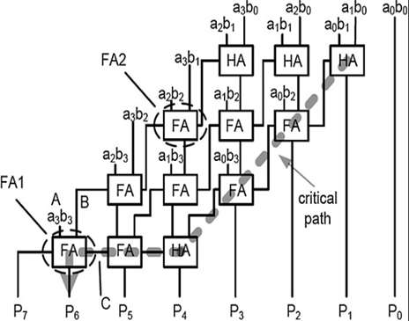
Introduction to compressor
It is used to reduce the length of the tree
It is used to reduce the critical path delay

Slide 4
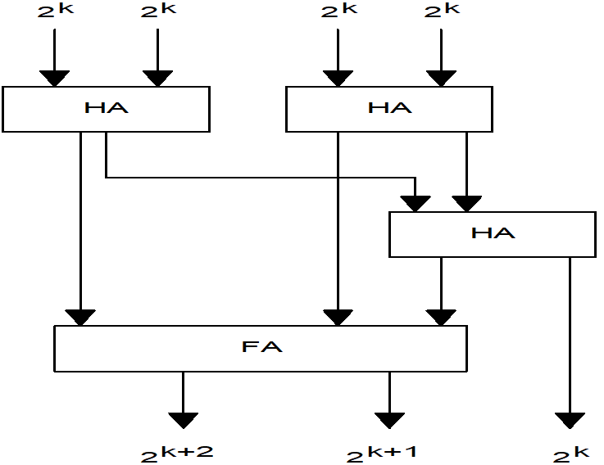
Existing 4-3 Compressor

Slide 5
Proposed 3-1-1-2 Compressor with 4:1 Mux

Slide 6
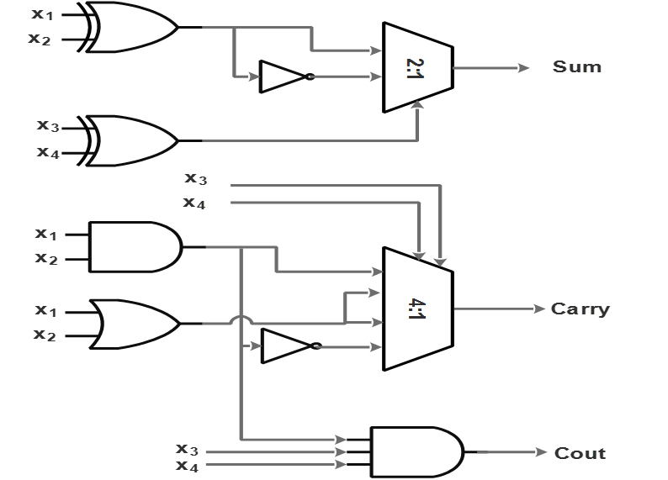
Proposed 3-1-1-2 compressor with 2:1 Mux

